Slide 1

Post-weaning diarrhea I statistics
By:
Malak Essam
Farah Amr
Youssef Ismail
Mazen Mohamed

Slide 2

Introduction
Post-weaning diarrhea (PWD) is a significant issue in pig farming worldwide, causing increased mortality, weight loss, retarded growth, and higher treatment costs. E-coli is the primary cause of PWD, and the current control strategy involves the use of antimicrobials. However, the emergence of antimicrobial resistance in E. coli necessitates alternative control strategies such as dietary fiber and reduced crude protein levels. Additionally, the use of zinc oxide (ZnO) has shown positive effects in controlling the disease. This study aims to compare the effects of different treatments on periods of ADWG0021, ADWG2150, ADWG0050: average daily weight gain (g/day) in the period between 0- and 21-days post-weaning, between day 21 and day 50 post-weaning and in the period between 0 and 50 days post-weaning, respectively.

Slide 3
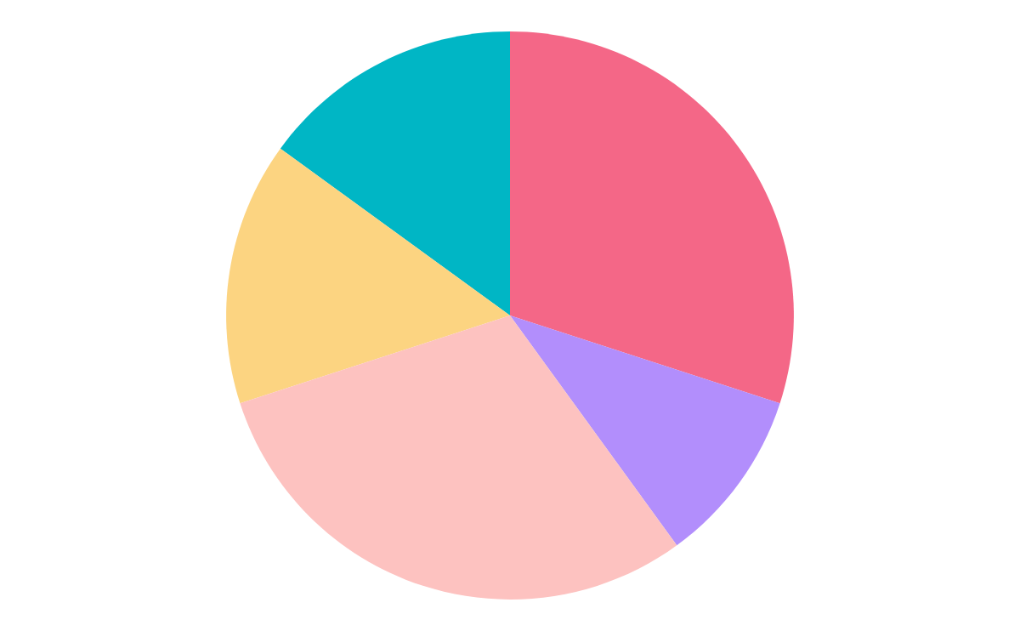
Dataset
We only have the total weights of the piglets living together in a pen.
Total piglets
680
Pen
8
Treatment Groups
5
16
Piglet in each pen
Piglet per treatment
128

Slide 4
Table of contents
1
Descriptive statistics
Testing normality, homoscadicity
4
2
Graphics
Statistical inference
5
3
Outlier detection
Hypothesis testing
6
7
Linear model

Slide 5
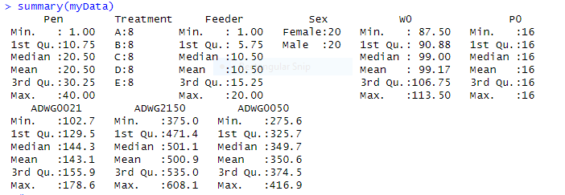
Descriptive statistics
We summarized our data and we found two categorical variables (Sex, Treatment). We calculated the mean, median, minimum, maximum, first and third quartile for each variable.

Slide 6
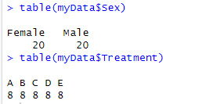
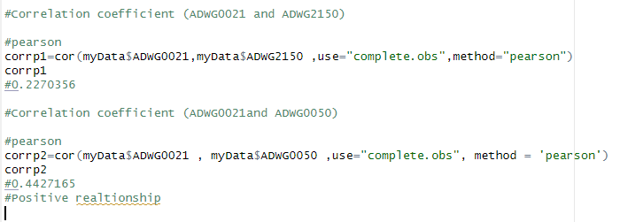
Then we calculated the frequency table for the categorical variables.
There is a positive relationship between (ADWG0021 and ADWG2150) and (ADWG0021and ADWG0050).

Slide 7
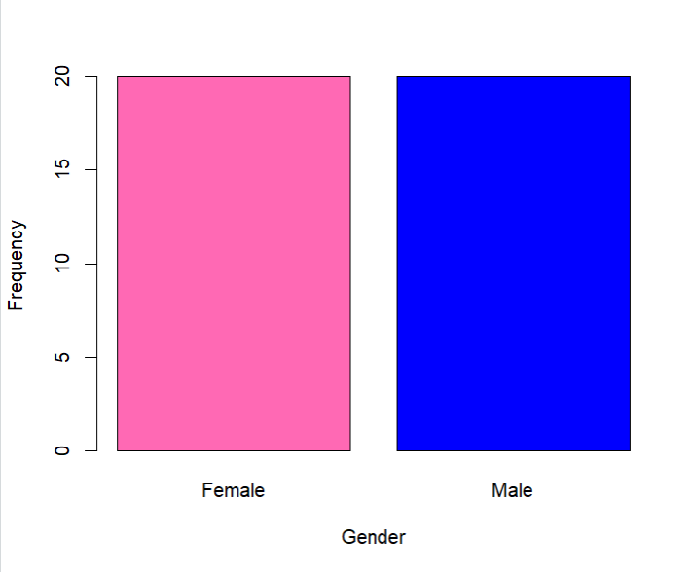
Bar chart of a categorical variable for the gender
Bar chart The distribution of the gender.
Geneder
Number 2 =Males
Number 1= Femals
X-axis is Gender.
Y-axis is the frequency of each gender.
Results
Showed that Females and Males
Equals 20.

Slide 8
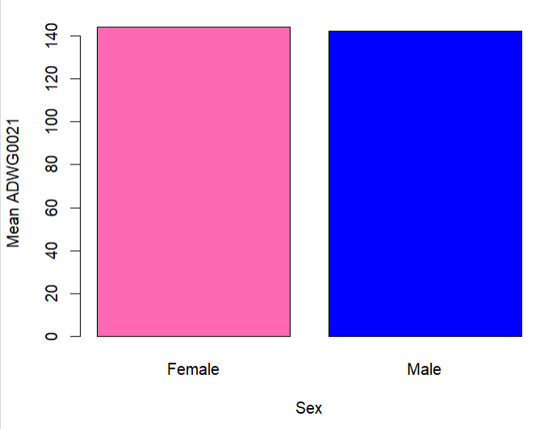
Bar chart graph with mean ADWG0021 in Males and Females.
Bar chart The distribution of ADWG0021 in each gender.
Geneder
Number 2 =Males
Number 1= Femals
X-axis is Gender.
Y-axis is the mean of ADWG0021 in each gender.
Results
The mean of ADWG0021 is similar in males and females.

Slide 9
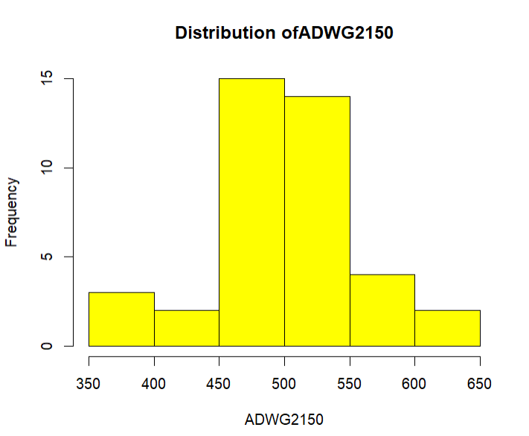
Histogram of a continuous variable: “ADWG2150”
Histogram is the distribution of ADWG2150 in our dataset.
X-axis is ADWG2150 values
Y-axis is the distribution of ADWG2150 values over the data set.
Results
Graph suggests normality.
Range is between 350 and 650.
Most of the piglets gained 450-550 g per day in this period.

Slide 10
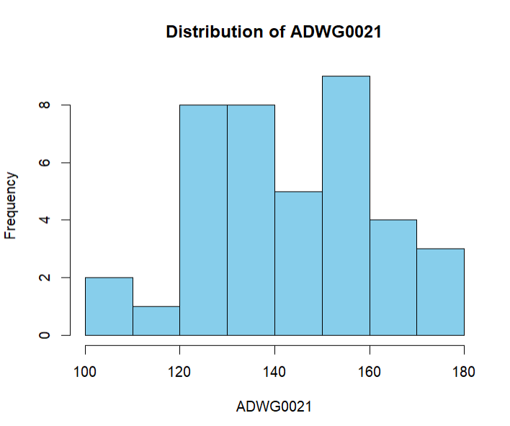
Histogram of a continuous variable: “ADWG0021”
Histogram is the distribution of ADWG0021 in our dataset.
X-axis is ADWG0021 values
Y-axis is the distribution of ADWG0021 values over the data set.
Results
Graph suggests normality.
Range is between 100 and 180, which means weight gain is small in ADWG0021.
More variability in weight gain across the piglets

Slide 11
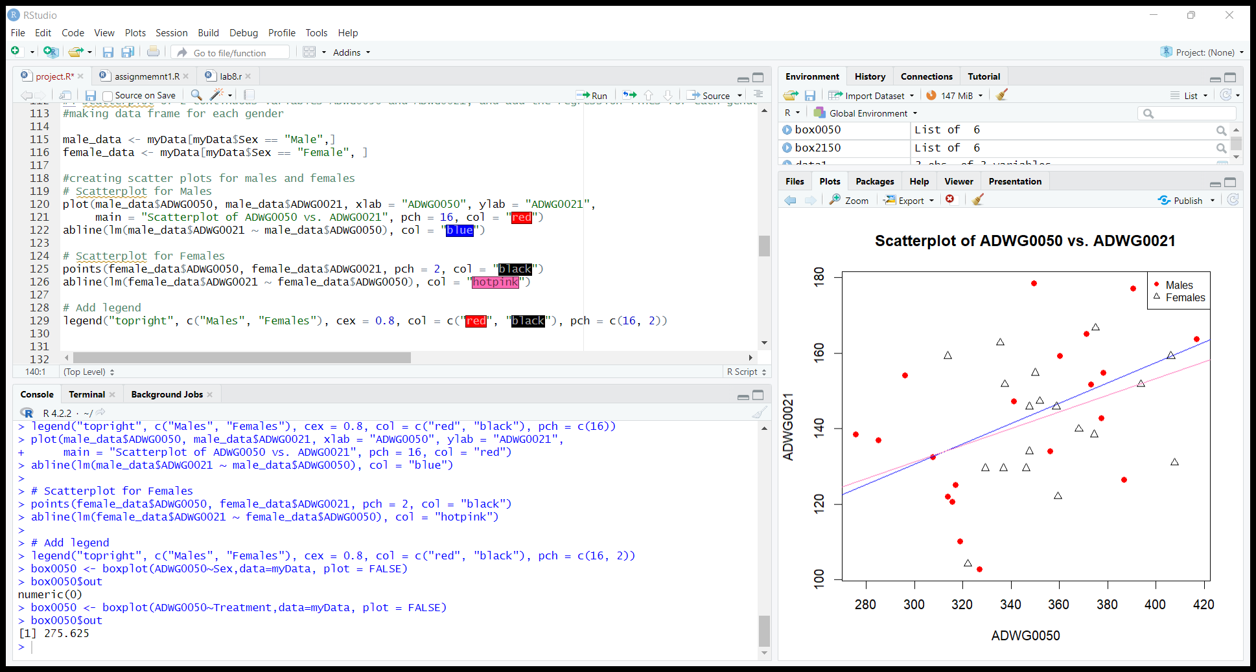
Scatterplot of ADWG0050 and ADWG0021 with regression lines for each gender.
Shows how ADWG0050 and ADWG0021 variables relate to one another
Lines
Blue line = Males
Pink line = Femals
X-axis is ADWG0050.
Y-axis is the ADWG0021
Results
Flat regression lines suggests that the data points are scattered randomly, without any clear relationship.

Slide 12
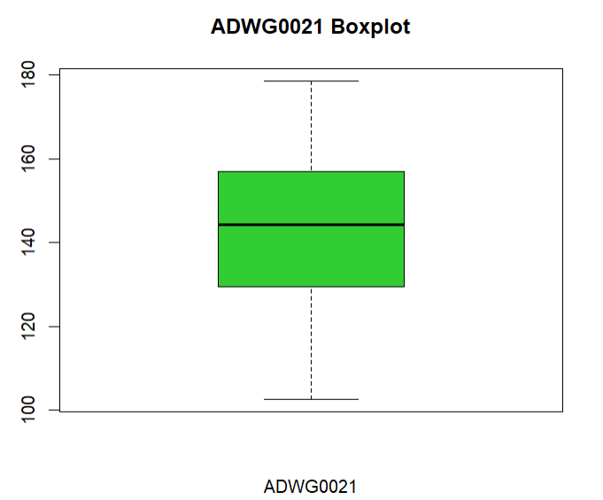
Boxplot of ADWG0021.
Shows us variations, median and any outliers
X-axis is ADWG0021 values
Y-axis is the distribution of ADWG0021 values over the data set.
Results
No outliers
Median is nearly 144
Most pigs gained between 130-160 g in the period of ADWG0021.
Ranger is between 100 and 180.

Slide 13
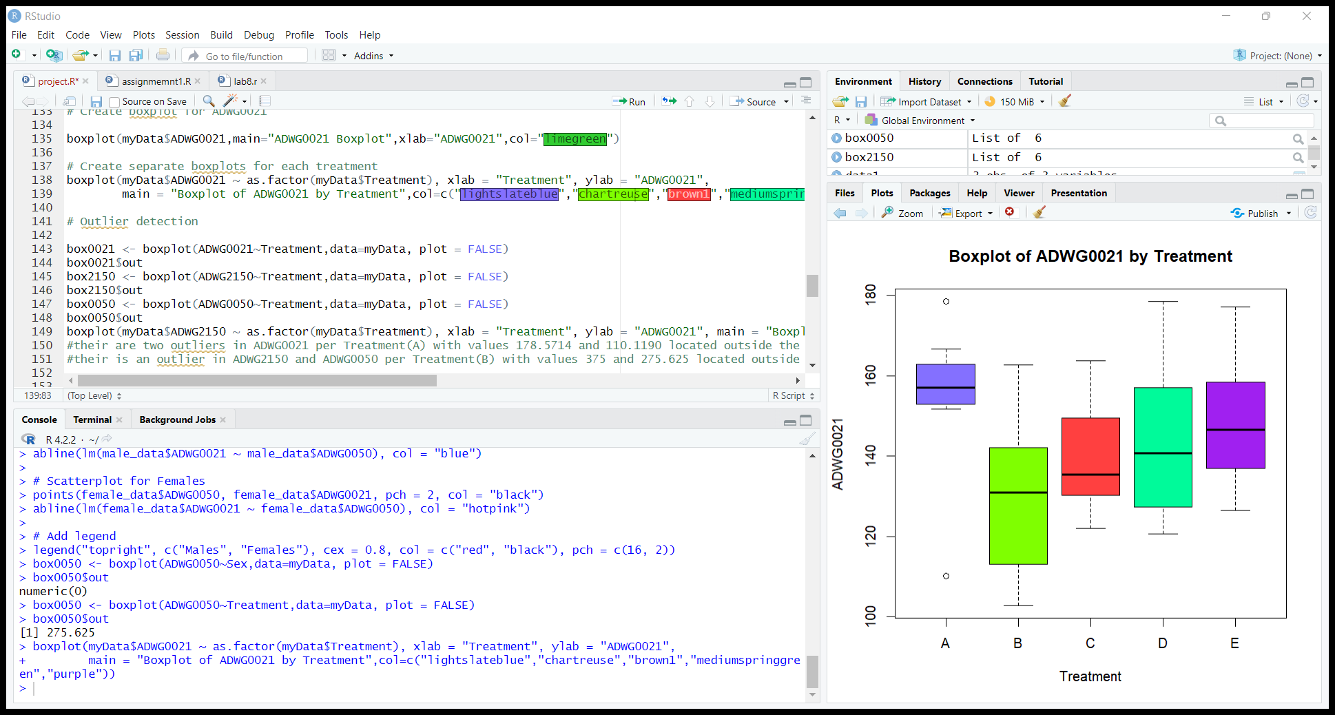
Separate boxplots per Treatment
Shows us variations, median and any outliers
X-axis is the treatment groups
Y-axis is the distribution of ADWG0021 across different treatments in data set.
Results
Two outliers in treatment A.
Treatment A shows the highest weight gain but lowest variations
Treatments B and D shows higher variability.
Treatment B has the lowest mean which indicates lower average weight gain.

Slide 14
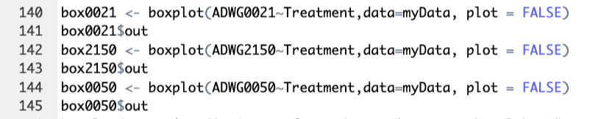
Outlier detection
We Explored the data by using boxplots for any existing outliers, identified them but we didn’t remove them.
Results :
We found two outliers in ADWG0021 per Treatment(A) with values 178.5714 and 110.1190 located outside the whiskers of the box plot
And another two in ADWG2150 and ADWG0050 per Treatment(B) with values 375 and 275.625 located outside the whiskers of the box plot.

Slide 15
Normality Testing
To assess the normality assumption, we performed a normality test on the data using the Shapiro-Wilk test, qq-plot. This test evaluates whether the data significantly deviate from a normal distribution.
The null hypothesis (H0) assumes normality.
the alternative hypothesis (H1) suggests a departure from normality

Slide 16
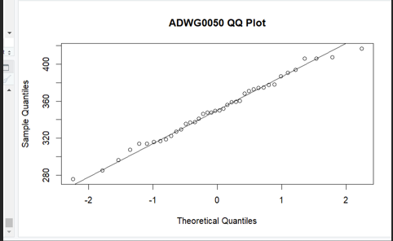
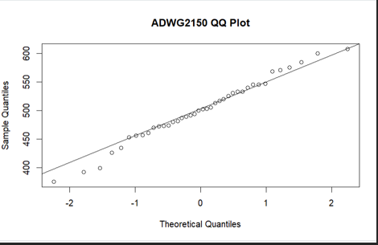
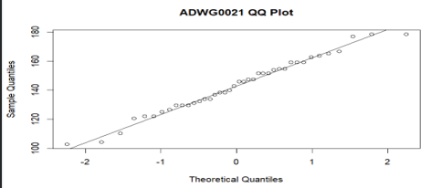
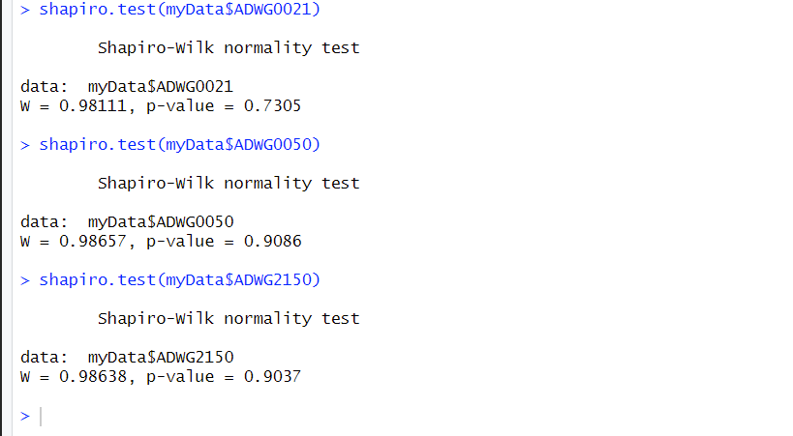
Results

Slide 17
The results of the normality test indicated that the data were normally distributed as the p-value for ADWG0021, ADWG0050, and ADWG2150 are greater than the significance level of 0.05. of p value= (0.7305,0.9086,0.9037) which mean we don’t have enough evidence to reject null hypothesis. It is worth noting that even if the normality assumption is violated, certain statistical tests are robust to moderate departures from normality, especially when the sample size is large. Additionally, visual examination of histograms, Q-Q plots, or other graphical methods can provide further insights into the distributional

Slide 18
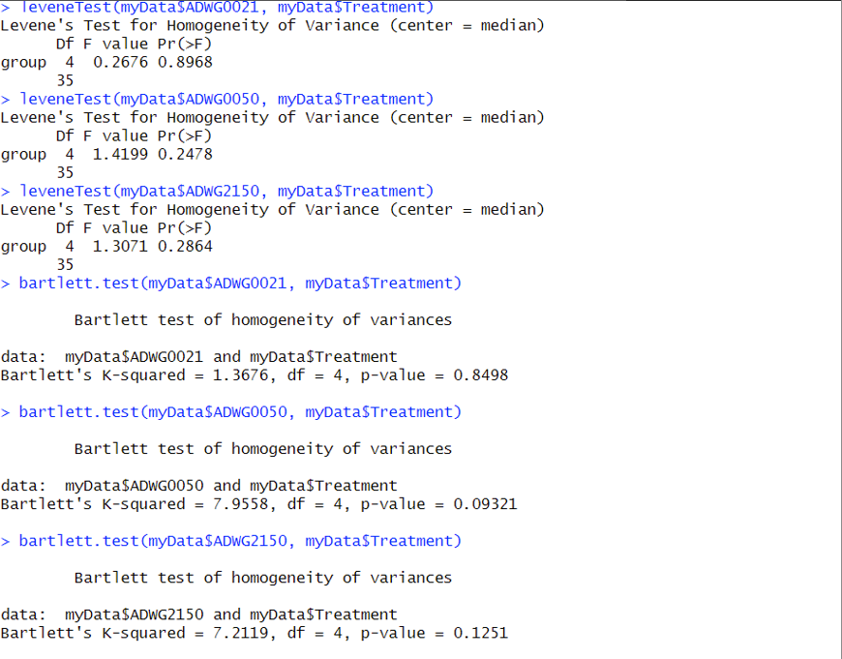
Homoscedasticity Testing
To examine the assumption of homoscedasticity, we conducted Bartlett's test, a Levene’s test.
This test assesses whether the variances of the dependent variable are equal across different levels of the independent variables.
The null hypothesis (H0) assumes homoscedasticity, while the alternative hypothesis (H1) suggests heteroscedasticity.
The results of the homoscedasticity test revealed that the assumption of homoscedasticity was not violated as all the values of p-values are greater than the significance level of 0.05
(0.8498,0.09321,0.1251)
which means that we do not have sufficient evidence to reject the null hypothesis

Slide 19

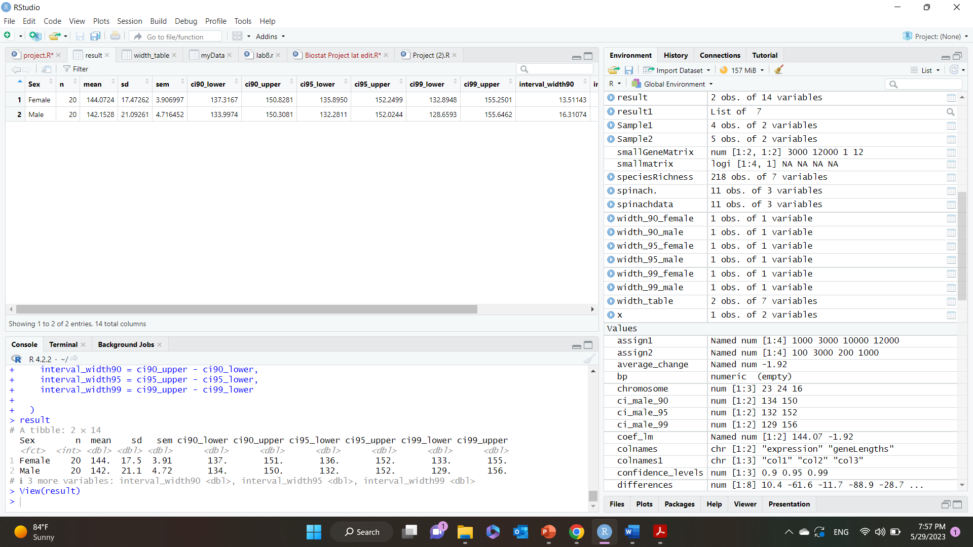
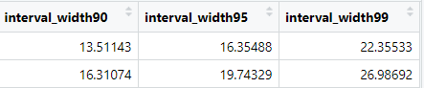
Statistics inference
We calculated the 90%, 95%, 99% confidence interval for the means of ADWG0021per each gender.
We are 90%, 95%, and 99% confident that the true mean ADWG0021 for males and females falls within the calculated confidence intervals.
We noticed that by increasing the confidence level, the width of the confidence interval also increases.
In 99% there is less precision but more confidence that we will capture the true mean.
In 90% we are more precise but less confidence.
Lower
interval
Upper

Slide 20
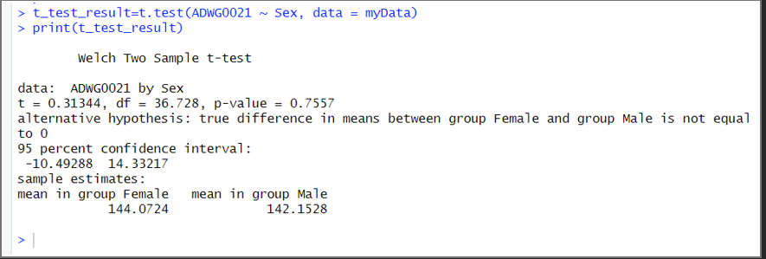
Hypothesis testing
1-We hypothesis that ADWG0021is different between male vs female. Assuming normality and homoscedasticity
Null Hypothesis : There is no difference in ADWG0021 between males and females.
Alternative Hypothesis: There is a difference in ADWG0021 between males and females.
we used Two-sample independent t-test which compares the means of two independent groups (males and females).
Results
The p-value = 0.7557 which is greater than the alpha of value 0.05, which means that we don't have enough evidence to reject the null hypothesis that There is no difference in ADWG0021 between males and females.

Slide 21

Assessing assumptions for the t-test:
Normality:
Test assumes: Normality of the ADWG0021
For males and females.
We assessed normality visually using a histogram and a QQ plot, as well as statistically using the Shapiro-Wilk test
Equality of variances:
Test assumes: Homoscedastic ADWG0021 For males and females.
We checked assumption of homoscedastic using Levene's test or the F-test for equality of variances.

Slide 22
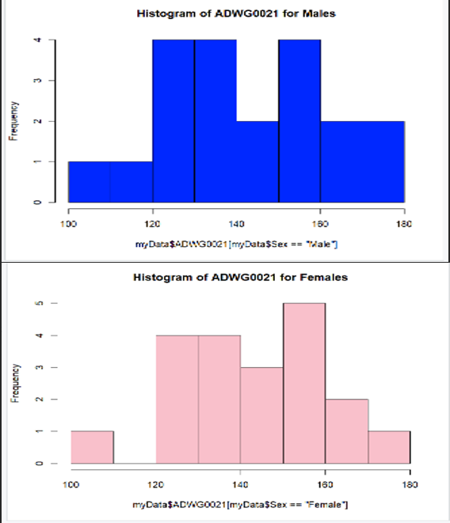
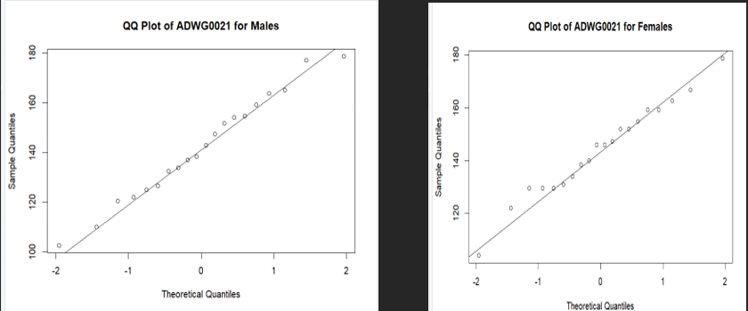
Results(Normality)

Slide 23
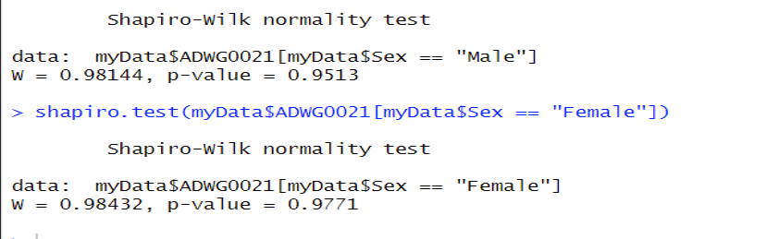
Results
The p-value from the Shapiro-Wilk test is greater than the significance level, it indicates that there is not enough evidence to conclude that the data significantly deviate from a normal distribution.

Slide 24
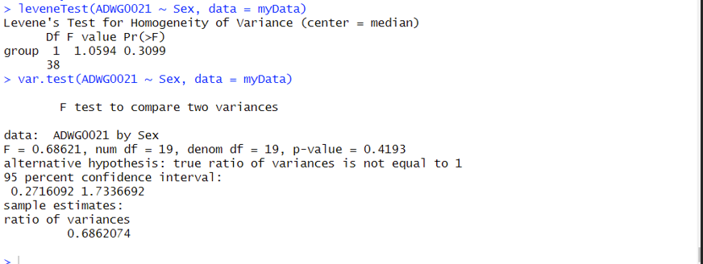
Results(Equality of variances)
Based on these results and a significant level of alpha= 0.05, there is no significant evidence to suggest differences in variances between the Gender or a significant difference in the ratio of variances. Therefore, you can proceed with the assumption of equal variances in your analysis.

Slide 25
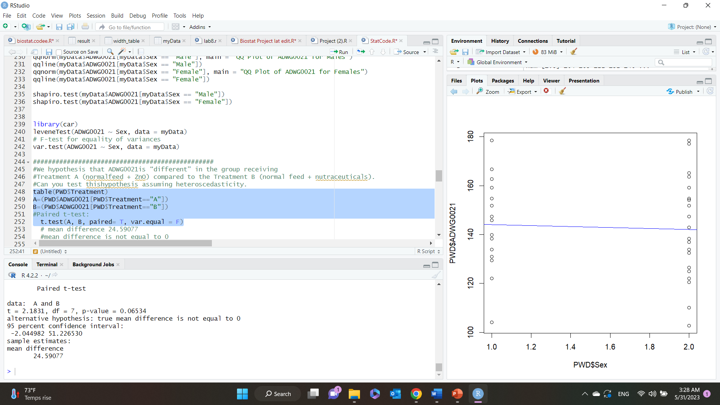
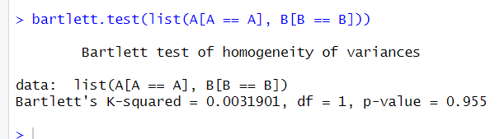
Hypothesis testing
2-We hypothesis that ADWG0021is “different” in the group receiving Treatment A compared to the Treatment B , assuming heteroscedastic.
Null hypothesis: ADWG0021is “different” in the group receiving Treatment A (normal feed + ZnO) compared to the Treatment B (normal feed + nutraceuticals).
Alternative: There is no difference.
Result:
mean difference 24.59077
mean difference is not equal to 0
P-value(0.06534) is greater that alpha value (0.05) so we don’t have enough evidence to reject null hypothesis
Bartlett test of homogeneity of variances
Null (HO) means there is no difference in variance,
Alternative (H1) means there is differences in variance (Heteroscedastic).
Results:
Since the p-value is 0.955, which is greater than the typical significance level of 0.05, we do not have enough evidence to reject the assumption of equal variances.

Slide 26

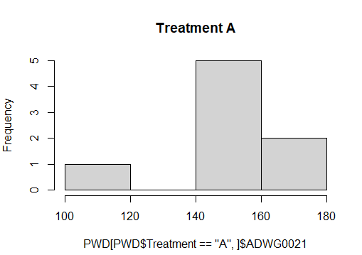
3- We hypothesis that ADWG0021 is different between the different Treatments
Null hypothesis: The mean of the treatment groups is equal.
Alternative hypothesis: The mean of the treatment groups is not equal.
Check normality using Histogram, QQ plot, and Shapiro test.
The range is between 100 and 180, which means weight gain is small in ADWG0021.
The graph is not normal.
The p-value is 0.0395 which is less than 0.05 so we have enough evidence to reject the null hypothesis which means that Treatment A is not normal.

Slide 27


We will check the homoscedasticity by using (Boxplot and Levene test)
Assume normality
The P-value is 0.8968 which is greater than 0.05 so we do not have enough evidence to reject the null hypothesis so the data is homo variance.
We will use the Kruskal-Wallis test because the data is not normal.
p-value = 0.09972, so we don’t have enough evidence to reject the null hypothesis, meaning there is no difference between the treatments in ADWG0021( Not significant).

Slide 28
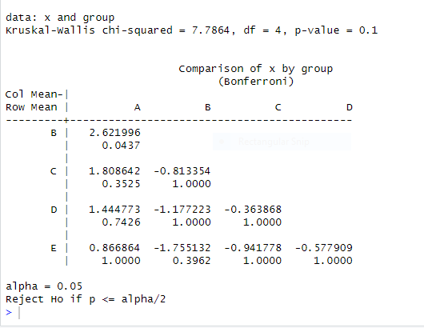

We will (assume normality and homoscedasticity).
ADWG0021 is the dependent variable, treatment is the independent variable.
p-value=0.101 which is greater than 0.05 so we do not have enough evidence to reject the null hypothesis which means that they are not significant.
B-A treatments have a p-value=0.0437 which is smaller than 0.05 so we have enough evidence to reject the null hypothesis the data is not normal and B-A treatments are different in ADWG0021.

Slide 29
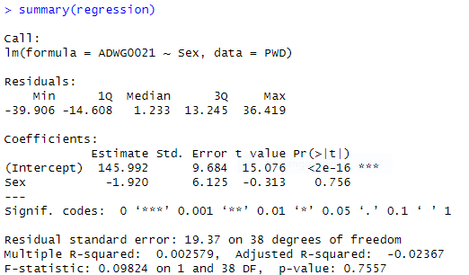
Linear Model
Fit a linear regression to the data and interpret the regression coefficient.
Null hypothesis: the slope equals zero, meaning y cannot be predicted by x.
Alternative hypothesis: the slope is not equal to zero, meaning y can be predicted by x
Here we measure the variance in the dependent variable (ADWG0021) (response) that can be predicted by the independent variable (Sex) (Explanatory) which means we have only one explanatory variable so this is a simple linear regression. We will use the multiple R-squared to know the percentage of Y being able to predict X, which equals 0.2579%.
The p–value=0.7557 which is greater than the significance level 0.05 so we do not have enough evidence to reject the null hypothesis (not significant), so Y can’t be predicted by X

Slide 30
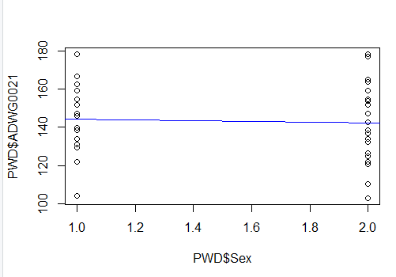
There is no linear relationship between the explanatory variable (sex) with the response variable (ADWG0021) the regression line is horizontal and seems to be zero so y (ADWG0021) can't be predicted by x (sex).

Slide 31
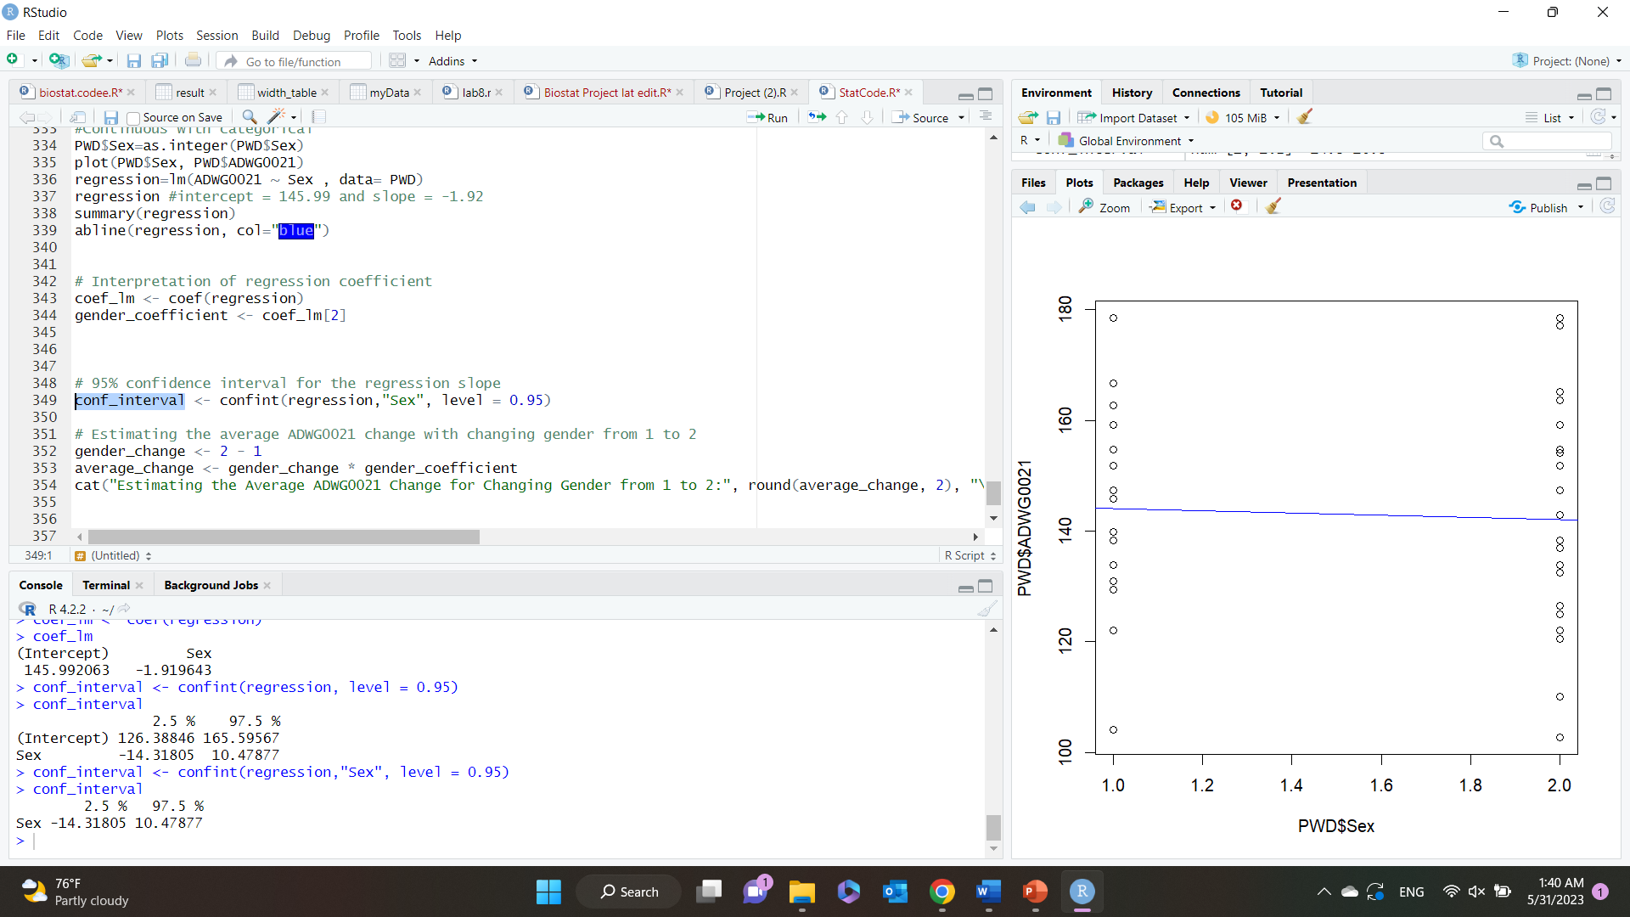
Calculate 95% confidence interval of the regression slope.
2.5%
97.5%
Interval is estimated to be between -14.31805 and 10.47877.
Null= Y( ADWG0021) can’t be predicted by X (Sex), slope = 0.
Alternative= Y( ADWG0021) can be predicted by X (Sex), slope != 0.
Since value of slope can be zero, this means that we don’t have enough evidence to reject the null (Y cannot be predicted by x)

Slide 32
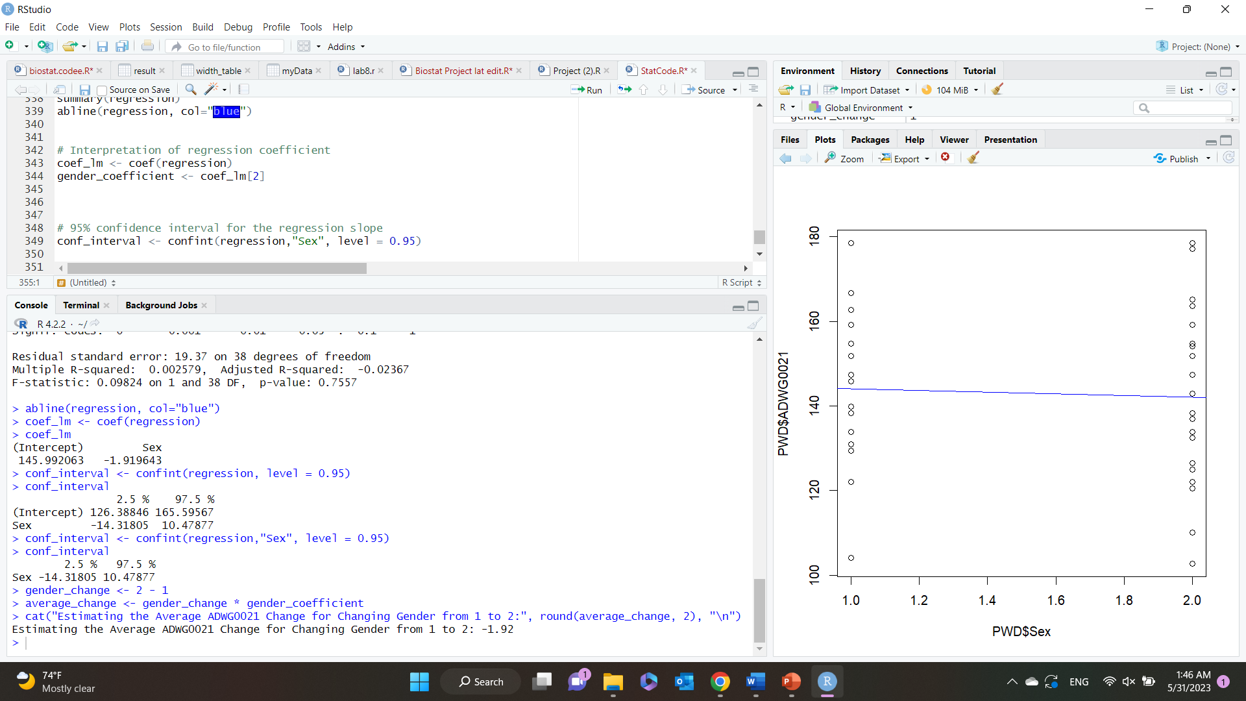
Estimating the average ADWG0021 changes with changing the gender from Female to Male.
A coefficient of -1.92 for the "Sex" variable means that, there is an estimated decrease of approximately 1.92 units in the value of ADWG0021 when changing the gender from "Female" to "Male."
This suggests that, compared to females, males have a lower average value of ADWG0021.

